Slide 1
“Guardian Gear
Advancing Safety with Smart Mining Helmets”
Under the Guidence of
Pratham M
Prabhuswamy
Sanath Kumar KS
Sudeep G
Prof. Eshwari A Madappa
Dept of Electronics and Communication Engineering

Slide 2
What is Smart Helmet For mining
Our smart helmet represents a groundbreaking advancement in mining safety, offering the potential to drastically decrease workplace accidents and improve overall worker safety through data-driven safety management and enhanced situational awareness.

Slide 3
Problem Statement
Persistent Risks: Even though miners play a vital role in society, they are nonetheless subject to constant risks such dangerous conditions, falling items, and toxic gasses, which calls for enhanced safety precautions.
Current Limitations: Although worker safety is the top priority in mining operations, the safety regulations and monitoring systems in place may not be sufficient to fully address the needs of miners.
Creative Solution: Using state-of-the-art technology, our mining smart helmet revolutionizes safety regulations by providing real-time hazard identification and communication capabilities to improve miner protection.
Mission Objective: Our project's goal is to minimize hazards, guarantee safe working conditions, and make a positive impact on a safer and more sustainable mining sector by putting miner safety first while optimizing production.

Slide 4
Objective:
The primary objective of a smart helmet for mining people is to significantly enhance safety in the mining environment and minimize the risk of accidents and injuries. This is achieved through various functionalities:
1. Real-time environmental monitoring:
Toxic gas levels
Temperature and humidity
2. Enhanced worker safety and well-being:
Fall and collision detection
Improved visibility
3.Effectivecommunication and coordination:
Enable real-time communication
Worker location tracking

Slide 5
HW Component:
Arduino Uno: Microcontroller board used for data processing and control.
DHT11 Sensor: Temperature and humidity sensor.
LoRa Transceiver: Module for long-range wireless communication.
GPS Sensor: Global Positioning System module for location tracking.
Impact Sensor: Sensor to detect sudden movements or impacts.
Low-Quality Helmet (for demonstration purposes): Helmet used to house the components securely.
Arduino Uno Cable: Used for connecting the Arduino Uno to a computer for programming and debugging.
Wires (M2M, M2F, F2M): Used for making connections between components.
MT76813DBI ESP8266 Serial WiFi Wireless Gain Antenna: WiFi module for wirelesscommunication

Slide 6
SW Component:
Arduino IDE: Integrated Development Environment for programming the Arduino Uno.
LoRa Communication Protocol: Protocol for wireless communication between the smart helmet and a base station.
WiFi Communication Protocol: Protocol for transmitting data over WiFi for IoT integration.

Slide 7
Block Diagram:Tx Side

Slide 8

Block Diagram: Receiver Side
Temperature not in range
Toxic Gas Detected
LoRa
Transceiver
From Tx Side
Collision Detected
Uneven Humid
Location being Tracked

Slide 9
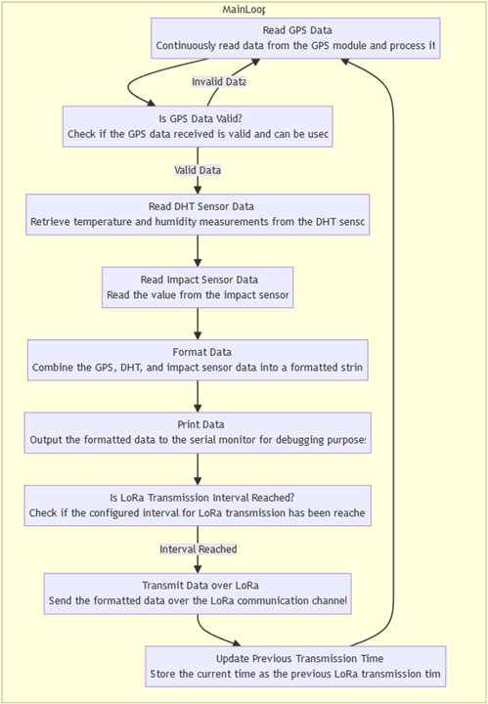
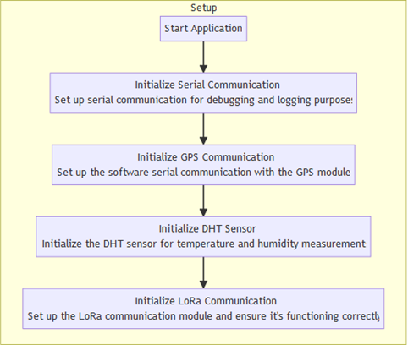
Flow Chart

Slide 10
Literature Survey Overview:

Slide 11
Smart Helmet-Based Personnel Proximity Warning System for
Improving Underground Mine Safety
Introduction: Underground mines face safety challenges, notably equipment collisions leading to fatalities.
PWS Development: Proximity Warning Systems (PWSs) developed to prevent collisions, using RFID and BLE.
Wearable PWSs: Smart vests, glasses, and helmets offer bidirectional warnings for enhanced safety.
Advantages of Smart Helmets: Provide real-time warnings without interrupting work, improving operator awareness.
BLE Signal Challenges: Difficulties in stable signal transmission due to mine conditions like rough walls and interference.
Performance Evaluation: Tested BLE signal detection distances and workload in real mine environments.
Future Directions: Potential for integrating additional sensors for comprehensive safety measures.

Slide 12
Smart Helmet for Detection of unsafe events in Mining Industry based on IOT
Introduction: Smart helmets enhance miner safety in mining environments.
Key Features:
Air quality monitoring detects harmful gases.
Hazard detection includes helmet removal and collisions.
Efficient lighting systems improve visibility underground.
Wireless Monitoring:
ZigBee-based systems monitor environmental parameters.
Real-time data aids decision-making for safety management.
Gas Monitoring and Safety Cut-off:
Continuous tracking of methane and carbon monoxide levels.
Automatic power cut-off upon detecting unsafe gas concentrations.
Conclusion:
Smart helmets advance safety in mining operations.
Ongoing research crucial for further safety innovations.

Slide 13
Smart Safety Helmet in Coal Mining Using Arduino
Introduction: Safety is paramount in underground coal mining.
Communication:
Transition to wireless communication (RF).
Improved flexibility and real-time data exchange.
Sensors:
Smart sensors in safety helmets.
Real-time monitoring of gas, temperature, and environmental conditions.
Monitoring & Control:
Wireless sensor networks (WSNs) with DVR.
GUIs for centralized supervision and swift response.
Conclusion:
Significant advancements enhance safety.
Ongoing research promises further improvements.
Vital for safeguarding mine workers and reducing accidents.

Slide 14
Advantage:
Impact Detection
Improved Contextual Awareness
Enhance Productivity and Efficiency
Decreased Downtime
Better Instruction
Regulation Compliance
A favorable Public Perception

